Slide 1

Customer Acquisition Strategy for Sunrun
Solar Adoption Case
Team 14 – Team Combo
Sheel Vora
Stephanie Ziritt
Kevin Castillo
April 10, 2019

Slide 2
Context
Sunrun is the nation’s largest residential solar provider.
Analyzed Google Project Sunroof data, California utility data by NEM and the Census data
Identify the gap between actual and potential solar customers by analyzing areas with greatest variance
Help Sunrun with solar customer acquisition
Identify market areas to venture into and detect which markets are losing momentum.

Slide 3
Business Problem
Renewable Energy Industry is growing!
Sunrun, the nation’s largest residential solar provider needs to stay competitive and continue acquiring customers
Challenge:
Analyzing multiple datasets to identify high potential markets
Identify certain demographics driving solar energy adoption

Slide 4

Model Methodology
Calculated variance (adoption) of solar installations by zip code (Current installations/Potential Installations)
Identified Top 20 and Worst 10 Zip Codes by Adoption Rate
Looked at Market Share in Top 20 Zip Codes to see where Sunrun stands
Compared demographics between Best Adopted vs Worst Adopted Zip Codes

Slide 5
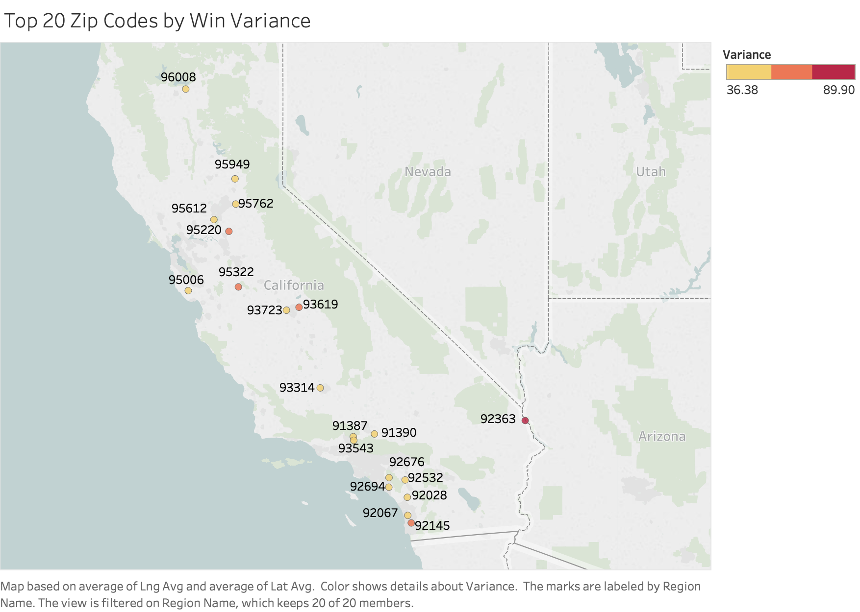
Most Adopted Zip Codes
Top Cities With Their Win Variance Include:
Fresno (39%)
El Dorado Hills (39%)
San Diego (52%)
Merced (71%)

Slide 6
Market Share in Top 20 Zip Codes
Solar City/Tesla holds highest market share for the Win Variance Zip Codes
Among the top solar providers, Sunrun occupies close to 3% market share

Slide 7
Electric Vehicles for Top 20 Zip Codes
Increasing number of electric vehicles in certain cities and zip codes
Explains Solar City’s high market share

Slide 8




Important Demographics
Type of structure
Occupancy
Single Unit vs Multi-unit and others
Average:
Best -> 84%
Worst -> 69%
By owner vs renter
Average:
Best -> 72%
Worst -> 58%

Slide 9




Recommendations
Partner with Mortgages Companies to advertise Sunrun
Target Car Dealers in potential zip codes t with electric cars to offer Sunrun as solar installer
Our Planet Documentary

